Slide 1
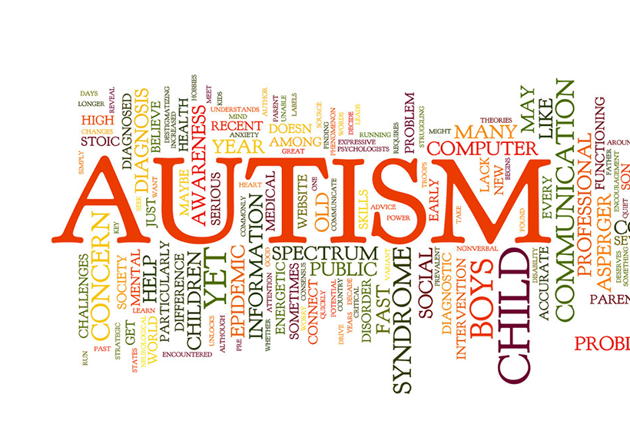
Project Title: Autism Detection

Slide 2
Team Members
Plabon Banik Mohammad Rifat Sarker Sayma Haque Arshe Md. Tahmid Zoayed
2019-1-60-167 2019-1-60-169 2019-1-60-021 2019-1-60-154

Slide 3
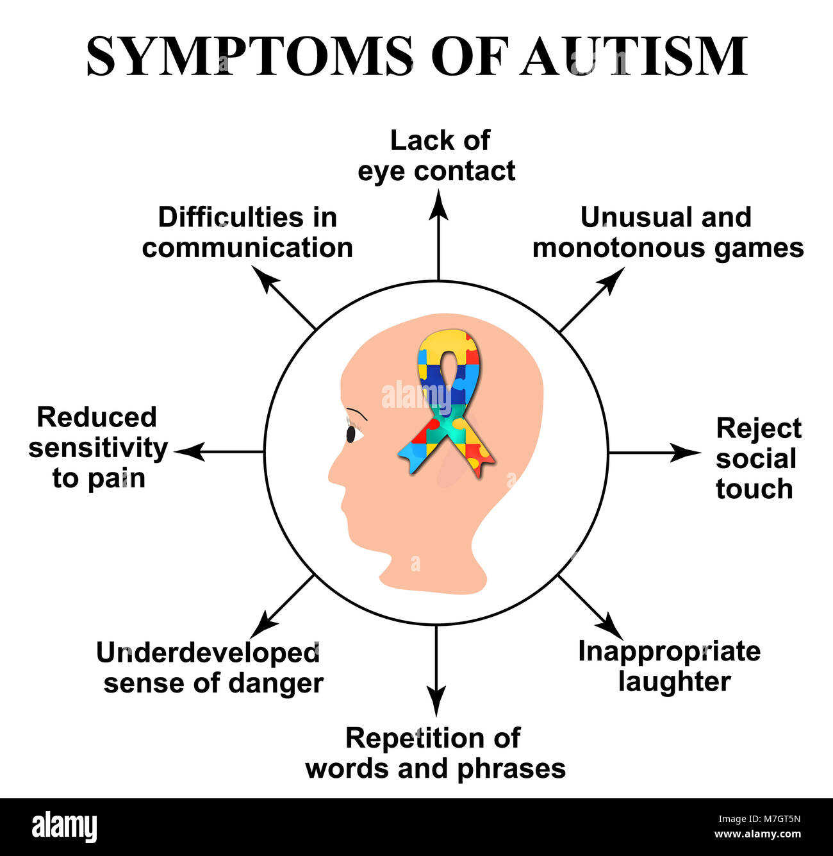
What is Autism?

Slide 4

How will this project help?
Through this project, we will be able to detect the autism patient through people’s behavior.
We have chosen a dataset which will be trained under certain algorithms and prepare a system to detect autism using attributes.

Slide 5

Dataset
From Kaggle (Link: https://www.kaggle.com/datasets/faizunnabi/autism-screening)
706 people’s records with 21 features

Slide 6

Sample Dataset
Id | A2_Score | ******* | Age | Class/ASD
1 | 1 | ******* | 26 | NO
2 | 1 | ******* | 24 | NO
3 | 1 | ******* | 27 | YES
4 | 1 | ******* | 35 | NO
5 | 0 | ******* | 40 | NO
6 | 1 | ******* | 36 | YES
7 | 1 | ******* | 17 | NO
8 | 1 | ******* | 64 | NO
9 | 1 | ******* | 29 | NO

Slide 7
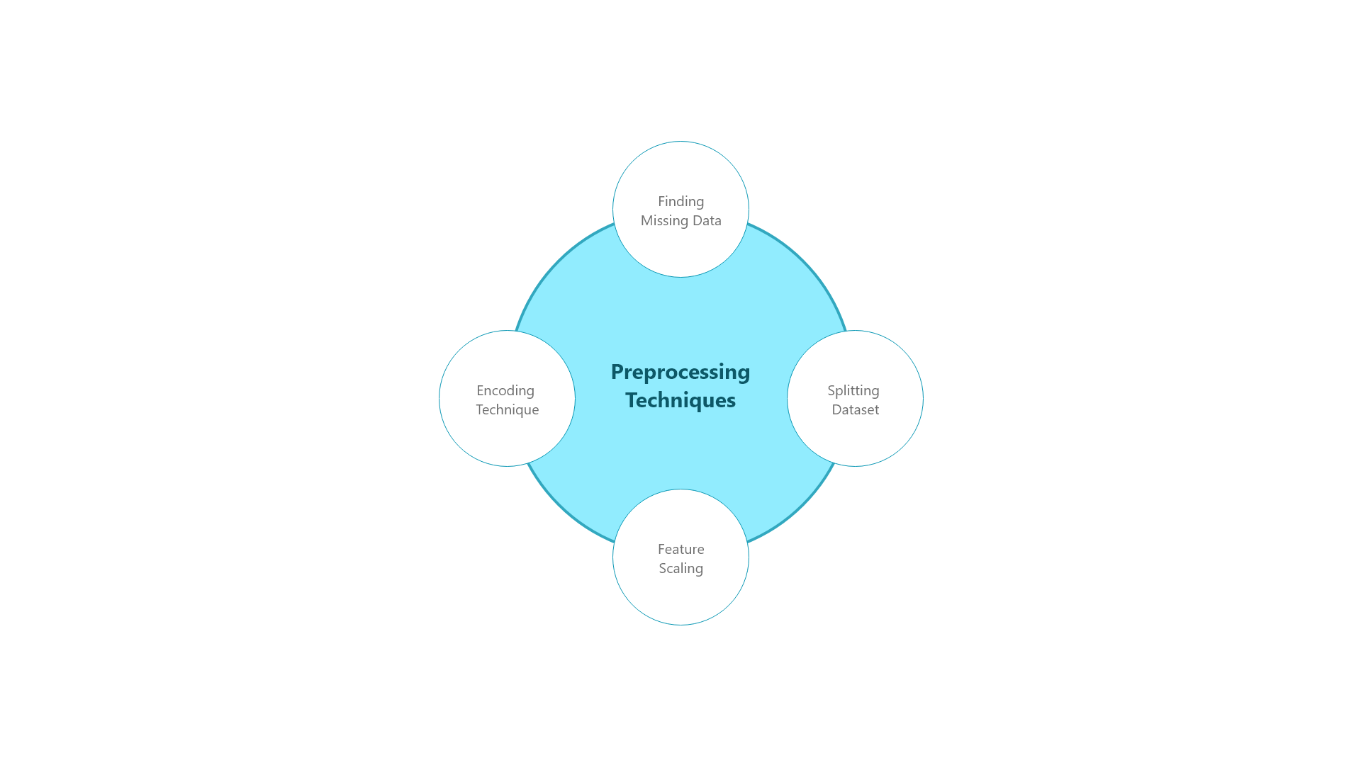
Preprocessing Techniques
Missing Data
- Checking the correlation of each attribute.
- By finding null values
- By deleting particular rows
- By calculating the mean, median, mode and switch them with null values.
Encoding technique like one hot level encoding.
Feature scaling
- Normalization
- Standardization
Feature Selection
Splitting dataset into training and test set

Slide 8
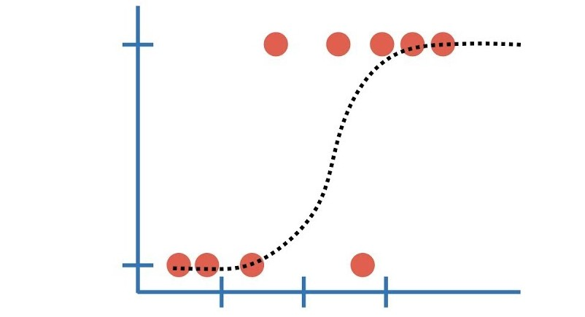
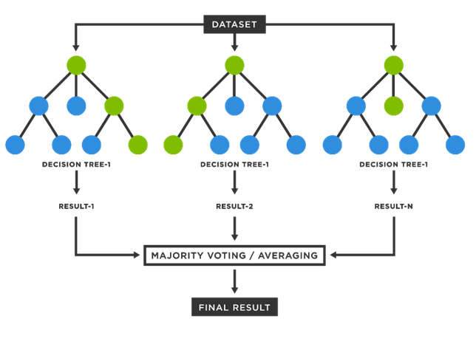
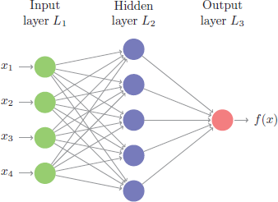
Logistic Regression
Machine Learning Techniques
Random Forest
Neural Network

Slide 9

Conclusion
We will keep the machine learning technique with optimal results. We’ll try different algorithms and finally select the best performing algorithm for this dataset which will help us to get the better version of the result.
Using machine-learning technologies to improve diagnosis, subtype classification, and support for people on the spectrum.

Slide 10

THANK YOU

